Slide 1
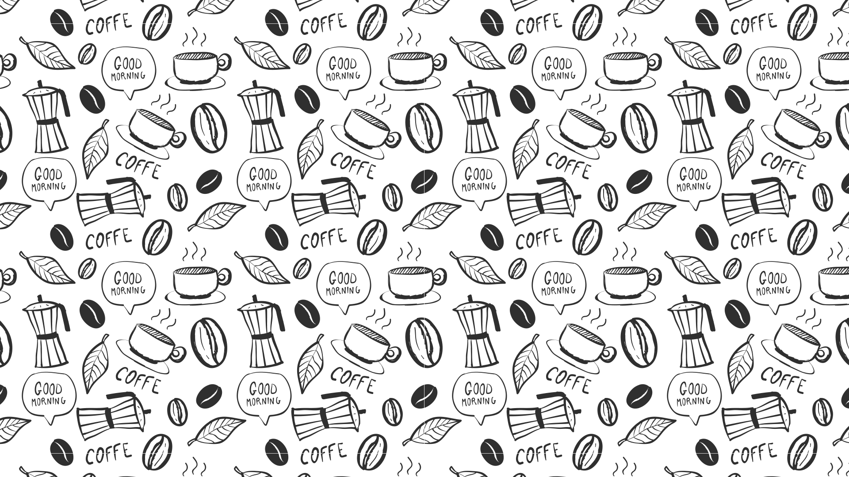

Folie 1
Machine Learning for Multi-Omics Integration
University of Barcelona (Spain), 15-17 December 2025
www.physalia-courses.org

Slide 2
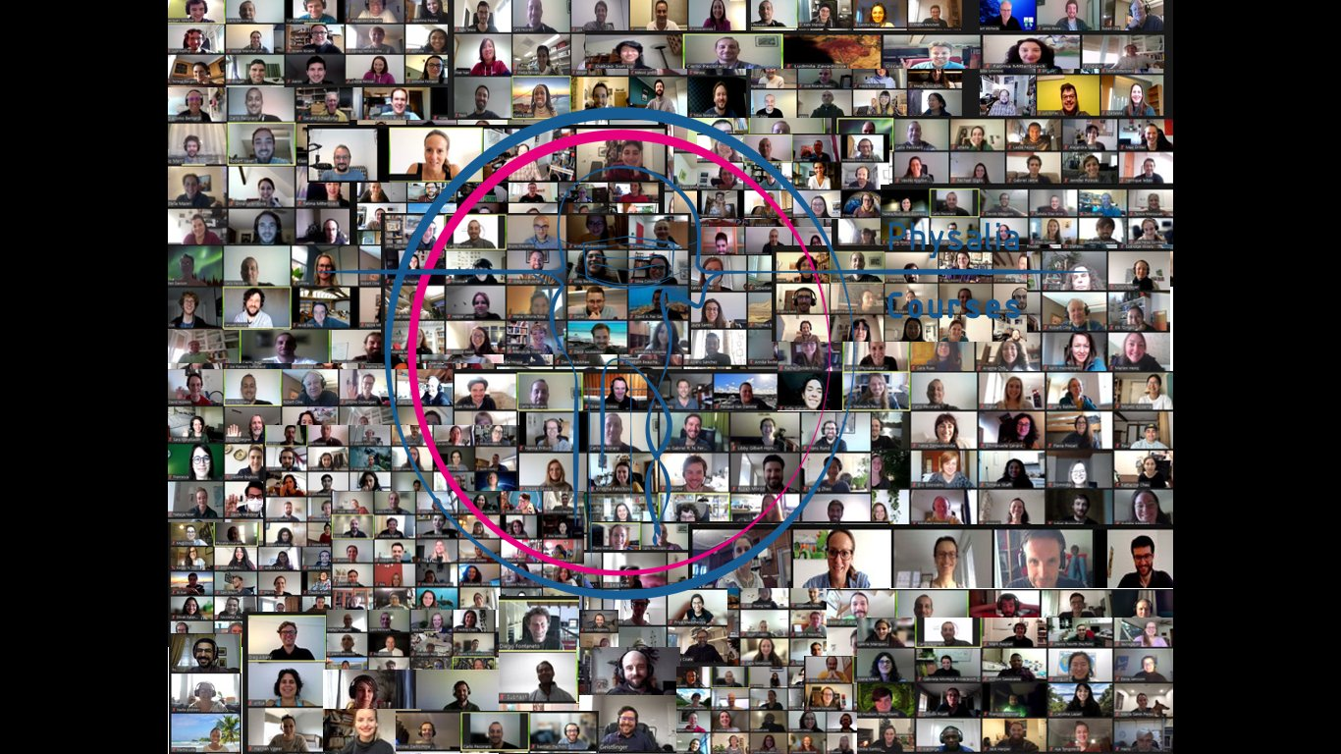
Folie 2

Slide 3
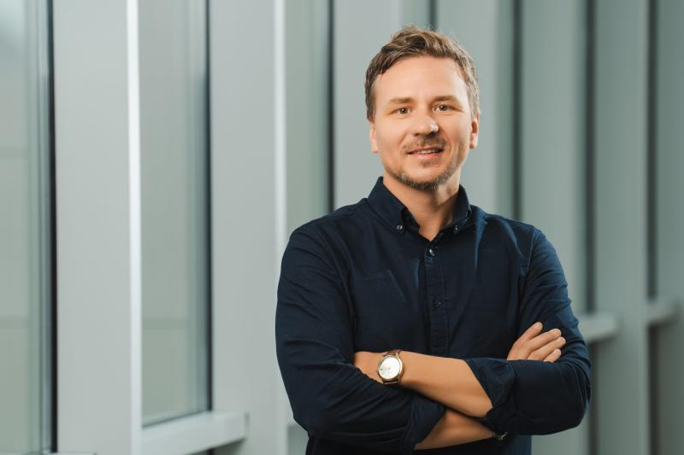
INSTRUCTOR
Dr. Nikolay Oskolkov
Group Leader at LIOS, Riga, Latvia
www.physalia-courses.org

Slide 4


Folie 6
Our 3-day course
Live sessions 9.30 – 16.30 (Barcelona time)
2 coffee breaks and a lunch break - 12:45 – 13:45
Please do not bring food to this room!
Certificate of attendance
Google Group
UNSERE PREMIUM-ANGEBOTE
Abgepackter Gourmet-Kaffee
Deluxe-Kaffeegetränke
Erstklassige lokale Gerichte
www.physalia-courses.org

Slide 5

Folie 6
Your Name
Your Research Institute
Why this course?
UNSERE PREMIUM-ANGEBOTE
Abgepackter Gourmet-Kaffee
Deluxe-Kaffeegetränke
Erstklassige lokale Gerichte
www.physalia-courses.org

